Slide 1
Indicator Variables
Part 2
BUAN / MECO 6312
Dr. Moran Blueshtein
University of Texas – Dallas.

Slide 2
Applying Indicator Variables
Interactions Between Qualitative Factors
Consider the wage equation with two indicator variables:
Including race and gender indicator variables will not capture interaction between these qualitative factors.
Is there a differential in wages for black women?

Slide 3
Applying Indicator Variables
Interactions Between Qualitative Factors
The expected value is:
White males are the reference group (for this group all indicator variables are 0).
measures the effect of being black relative to reference group.
measures the effect of being female relative to the reference group.
measures the additional effect of being black and female together

Slide 4
Applying Indicator Variables
Wage Equation with Race and Gender
Interactions Between Qualitative Factors

Slide 5
Applying Indicator Variables
Interactions Between Qualitative Factors
Holding the effect of education constant we estimate that:
Black males earn 4.17$ per hour less than white males (significant at 5%).
White females earn 4.78$ less than white males (significant at 5%).
Black females earn 5.11$ less than white men (interaction effect is not significant at 5% but is significant at 10% significance level)

Slide 6
Applying Indicator Variables
95% Confidence Interval for Wages of Black Women
Interactions Between Qualitative Factors

Slide 7
Applying Indicator Variables
Are White Females Discriminated Compared with Black Males?
Interactions Between Qualitative Factors
We don’t find statistically significant differences in wages between white females and black males (significance level 0.05)

Slide 8
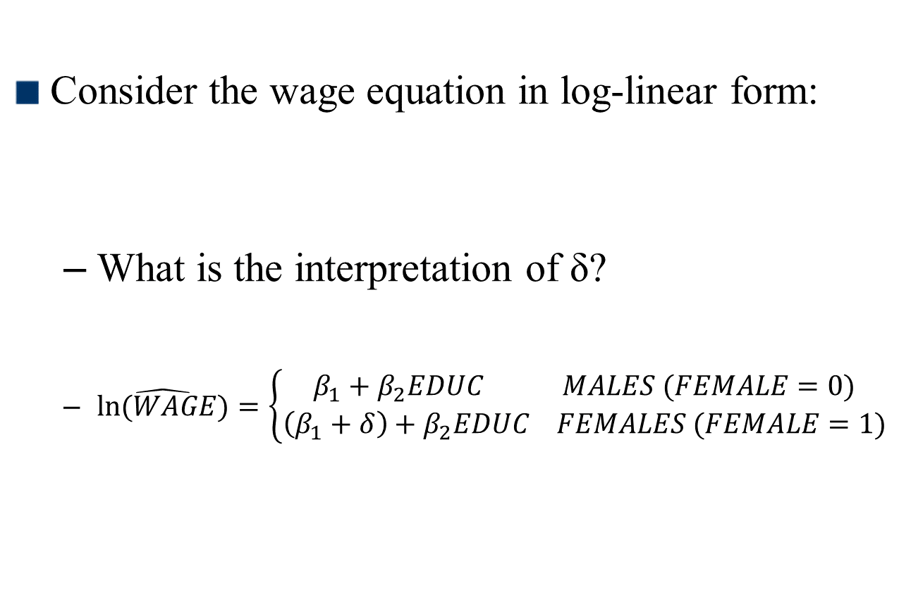
Log-linear Models
Consider the wage equation in log-linear form:
What is the interpretation of δ?
$\hat{ln⁡(WAGE)}=\left\{\begin{aligned}β_{1}+β_{2}EDUC MALES (FEMALE=0) \\ \left(β_{1}+δ\right)+β_{2}EDUC FEMALES (FEMALE=1)\end{aligned}\right.$

Slide 9
Log-linear Models
A Rough Calculation
Let’s first write the difference between females and males:
This is approximately the percentage difference

Slide 10
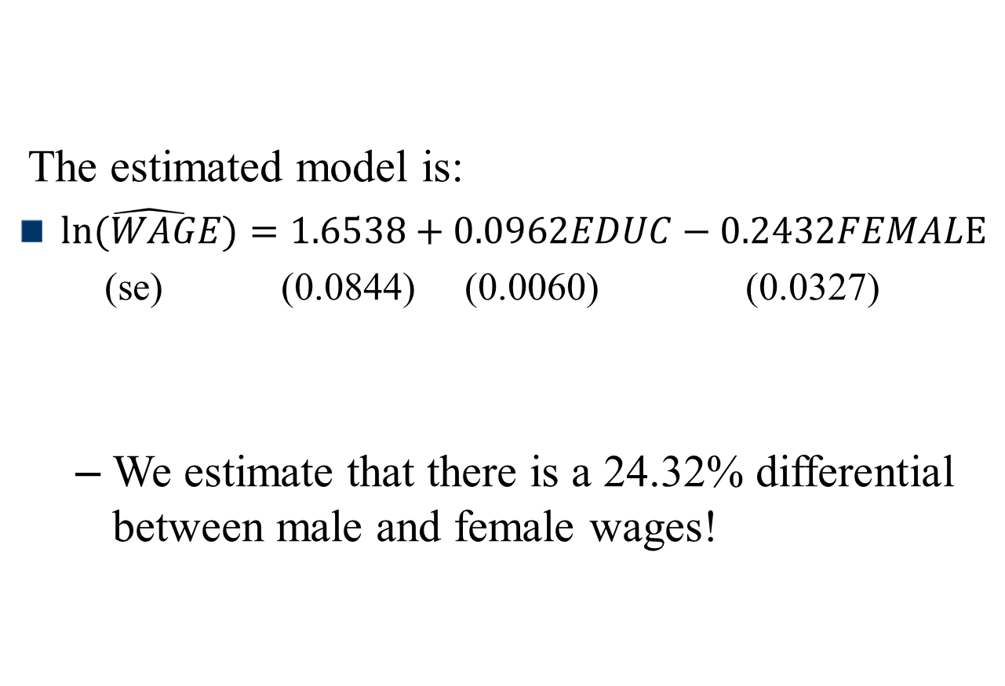
Log-linear Models
A Rough Calculation
The estimated model is:
$\hat{ln⁡(WAGE)}=1.6538+0.0962EDUC−0.2432FEMALE$
(se) (0.0844) (0.0060) (0.0327)
We estimate that there is a 24.32% differential between male and female wages!

Slide 11
Applying Indicator Variables
Qualitative Factors with Several Categories
What should we do if we have a qualitative variable that is not binary?
Assume we have data from four regions of the country
Since the regional categories are exhaustive, the sum of the regional indicator variables is 1:
NORTHEAST + SOUTH + MIDWEST + WEST = 1
We will create 3 indicator variables, and the omitted variable will be our reference group (doesn’t matter which variable):
Failure to omit one indicator variable will lead to exact multi-collinearity

Slide 12
Applying Indicator Variables
Qualitative Factors with Several Categories
Omitting one indicator variable defines a reference group so our equation is:
The omitted indicator variable, NORTHEAST, identifies the reference

Slide 13
Applying Indicator Variables
Testing the Equivalence of populations
And introducing both intercept and slope-indicator variables we get:
And for the reference group:

Slide 14
Applying Indicator Variables
Testing the Equivalence of populations
By introducing both intercept and slope-indicator variables we can test the hypothesis that the populations in different regions are completely different.
If there are no differences, then the data from the all regions can be pooled into one sample, with no allowance made for differing slope or intercept

Slide 15
Applying Indicator Variables
Testing the Equivalence of populations
If there are no differences at all between populations then:
Against the alternative that at least one coefficient
The Chow test is an F-test for the equivalence of two populations

Slide 16
Applying Indicator Variables
Testing the Equivalence of populations
If we want to test whether there are no differences between the SOUTH and the MIDWEST, then:
Against the alternative that at least one of the equalities doesn’t hold.

Slide 17
Applying Indicator Variables
Controlling for Time
Indicator variables are also used to capture time effects
Capturing an effect for different seasons/months of the year
Capturing the effect of specific days or holidays
Capture year effect.

Slide 18
Applying Indicator Variables
Testing the Equivalence of populations
Try it yourself!!!
You suspect there are regional differences between the South and other parts of the country.
How will you modify the regression model?
What are the null and alternative hypotheses for that test?
Test your hypothesis.

